Slide 1
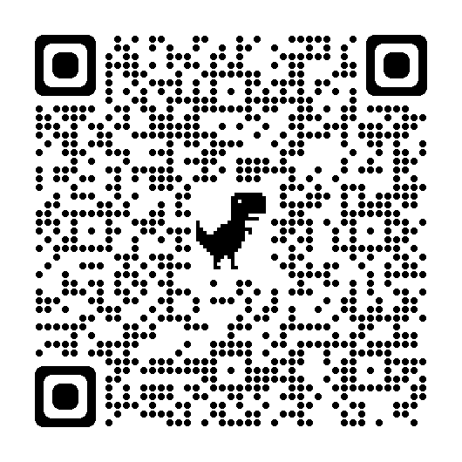
I assigned three small group work activities in discussion sections for Introduction to Logic. Here’s a brief description of the activities and how they went!
Scan this QR code with your phone camera for copies of the poster, assignments, and works cited.
Abstract
Three Small Group Work Activities
The Quick Version: undergrads in a logic course I TA-ed for expressed anxiety and self doubt about their logic derivation abilities. Following research that small group work improves retention in classes or academic programs (Springer et. al. 1999) or that it improves student self-esteem (Johnson, Johnson, and Smith 1998; Prince 2004)), I assigned three small group activities that facilitated learning of derivation strategies for Sentential Logic and Predicate Logic
Problem Based Activity students work in teams of four to solve a derivation set. Each student picks a role so the distribution of labor is fair and so students can target specific derivation-based skills. One roles is Strategist: the strategist is responsible for identifying sentential connectives and identifying strategies for solving the derivation. I used Padlet.com to host the assignment.
8/10
Peer Review Activity students work together in groups of three to provide quality feedback on proofs that commit a common derivation error (like not discharging an assumption), by identifying and explaining the error
9/10
Think, Pair, Share Activity: students work individually to think of short explanations of logical notions that are important for derivation strategies in Sentential Logic and Predicate Logic. Then, they are paired up with another student to check their understanding. To conclude the assignment, students work together to share one thing they learned about the notion.
9/10
What I would keep:
Scaffold with mini-lecture.
Focus on mistakes made in assignments
Group size
What I would change:
Model quality feedback prior to activity.
Introduce review or exit ticket at the end
What I would keep:
Group roles
Derivation sets
Group size
What I would change:
Padlet (not enough interface options for students)
Allow students the option to change roles
What I would keep:
Great review activity
Time limits
Icebreaker
What I would change:
Group size
The ‘share’ part
Three Small Group Work Activities for Learning Derivations in an Undergraduate Logic Class
by Jordan Dopkins jdopkins@ucsc.edu

